Slide 1
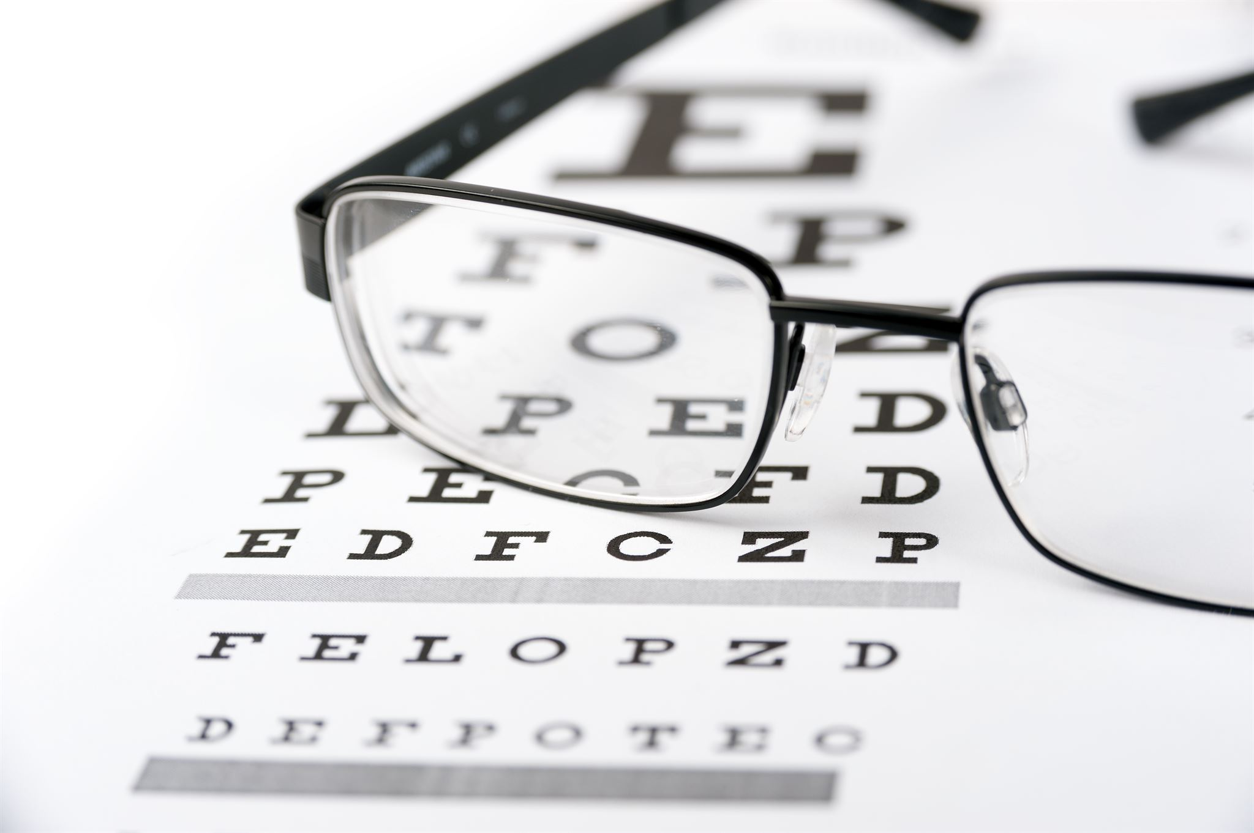
Welcome!
Notes:
Hello everyone and welcome to our presentation on the most innovative technologies in eyeglasses for consumers. In this presentation, we'll be discussing some of the exciting advancements that have been made in eyeglasses technology that can help improve your vision and enhance your day-to-day life.

Slide 2

1. Anti-Reflective Coatings
Reduce glare and reflections
Improve visual clarity
Scratch-resistant
Notes:
Anti-reflective coatings are becoming more widely available in eyeglasses and lenses. They help to reduce glare and reflections from computer screens, headlights, and other bright light sources. This can make it easier to see and improve visual clarity, especially when driving at night. Additionally, many anti-reflective coatings are scratch-resistant, giving your eyeglasses a longer lifespan.

Slide 3

2. Blue Light Filtering
Reduce eye strain and fatigue
Help regulate sleep patterns
Available in prescription and non-prescription lenses
Notes:
Blue light filtering technology is designed to reduce eye strain and fatigue caused by prolonged exposure to screens. It can also help regulate your sleep patterns by blocking blue light wavelengths that can interfere with your body's natural circadian rhythm. Blue light filters are available in both prescription and non-prescription lenses, making them a practical option for anyone who spends a lot of time in front of screens.

Slide 4
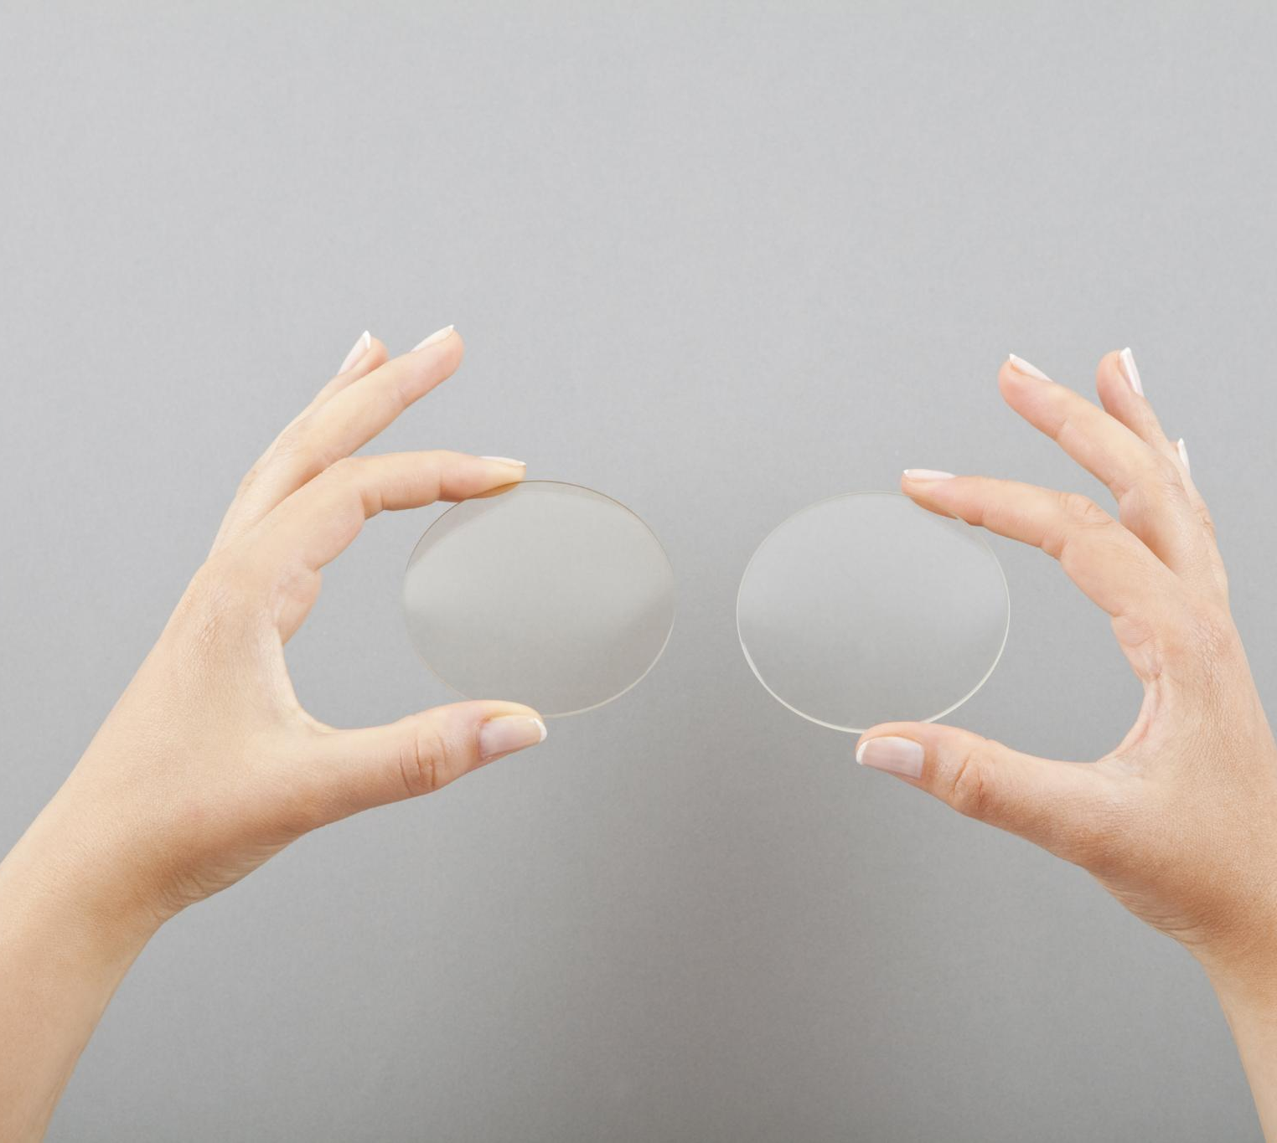
3. Digital Progressives
Multiple levels of magnification
Seamless transition between near and far vision
Designed for digital devices
Notes:
Digital progressives are a new type of lens technology that provide multiple levels of magnification and a seamless transition between near and far vision. They are designed specifically for digital devices, such as smartphones and tablets, and can help reduce eye strain and improve visual clarity when using these devices for extended periods of time.

Slide 5
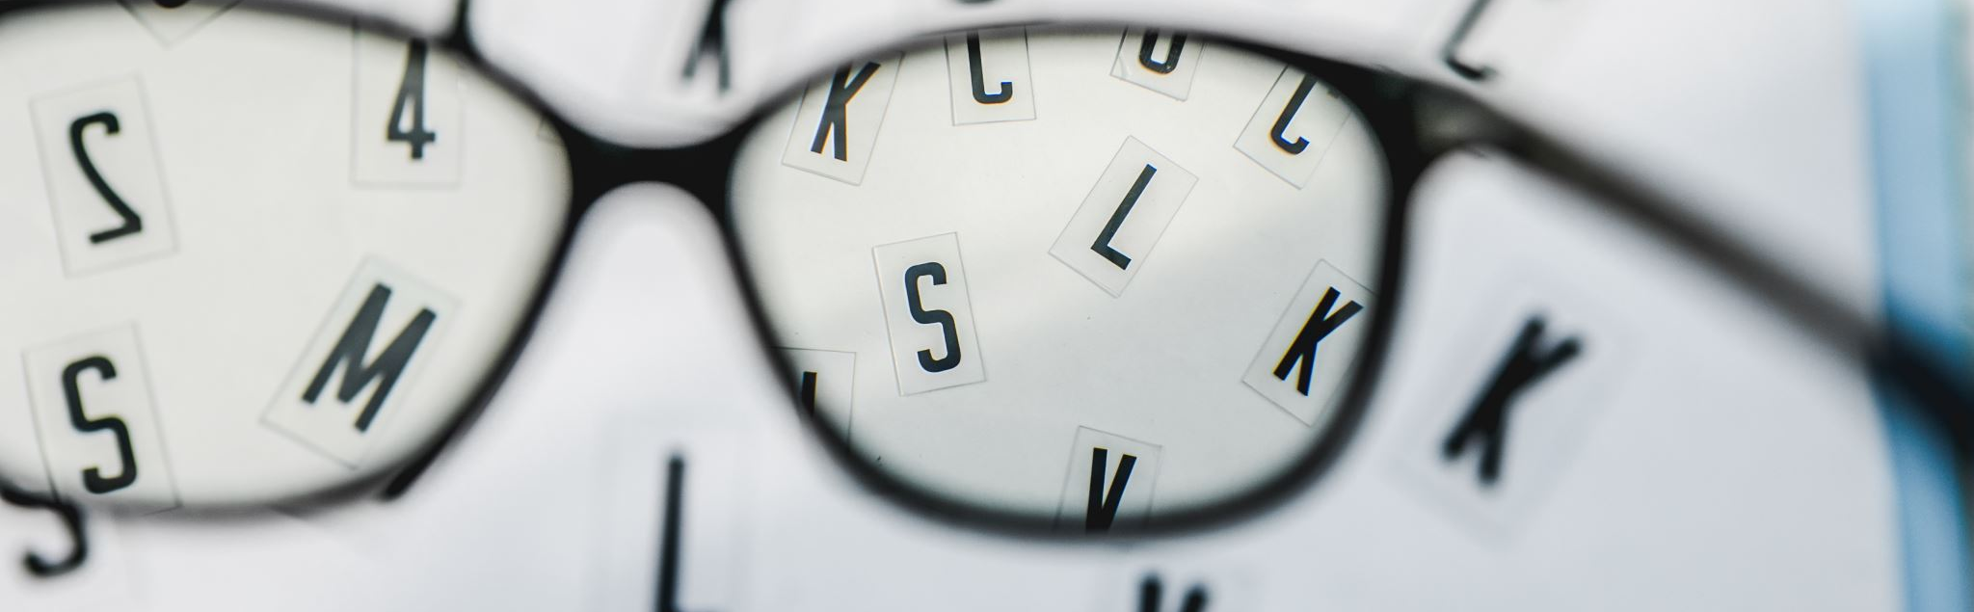
4. Adjustable Focus
Change focus with a turn of a dial
Great for reading and close work
No need to switch between multiple pairs of glasses
Notes:
Adjustable focus eyeglasses allow you to change focus with a turn of a dial. This makes them great for reading and close work, as you can easily adjust the focus to suit your needs. They are also a great option for people who need different magnifications for different activities, as you can switch between them without needing to switch between multiple pairs of glasses.

Slide 6
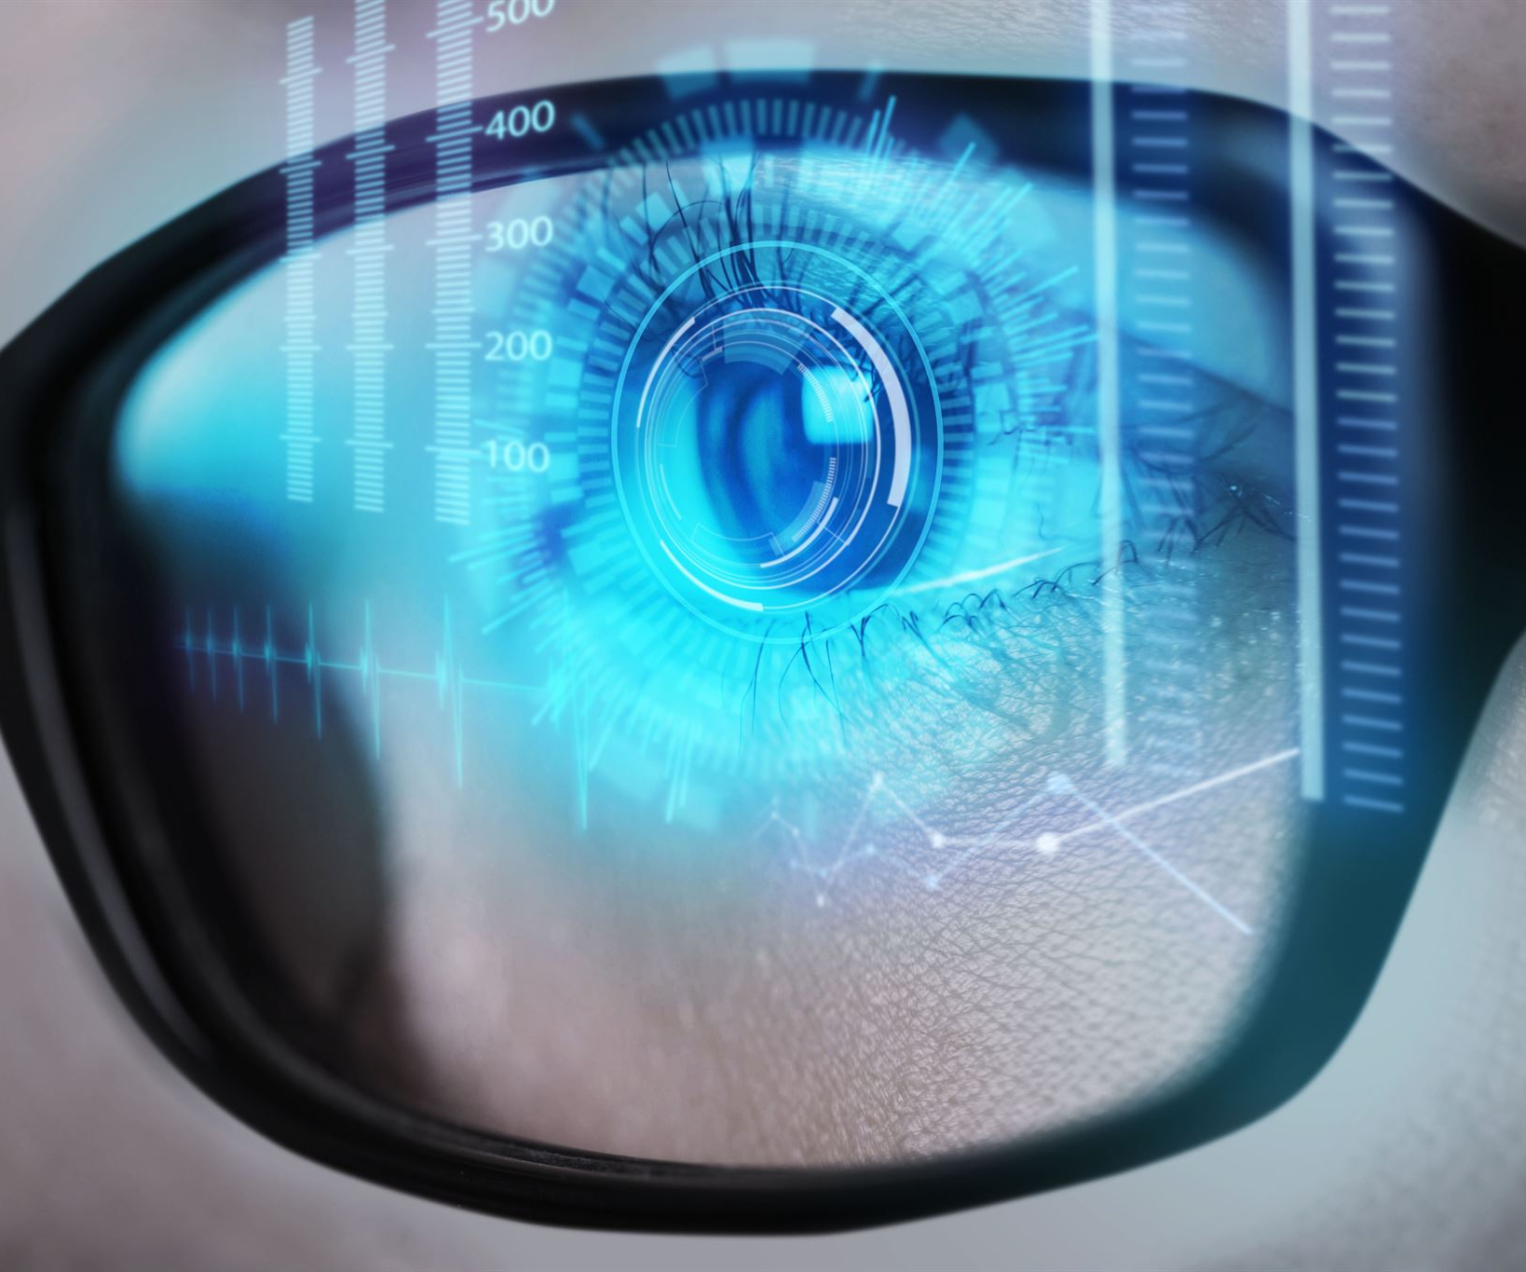
5. Smart Glasses
Augmented reality capabilities
Voice-controlled
Wireless connectivity
Notes:
Smart glasses are an exciting new technology that have the ability to overlay digital information on top of the real world. They can be voice-controlled and have wireless connectivity, allowing you to access information and control other devices hands-free. While still in their early stages, smart glasses have the potential to revolutionize the way we interact with technology and the world around us.

